Slide 1

Do-Now
What is engineering?
Go to menti.com
Enter code 30 58 73
Notes:
https://www.mentimeter.com/app

Slide 2


Science Share-A-Thon
November 17, 2018

Slide 3
Overview
Our agenda for today:
9:00 – 9:30: Continental breakfast, check-in, mingle
  Menti-Meter Poll
9:30 – 9:50: Engineering Challenge
9:50– 10:10: Engineering Design Cycle
10:10 – 10:30: Engineering and the New Science Standards
10:30 – 11:20: Grade band breakouts
11:20 – 11:30: Wrap up, door prizes, interest survey

Slide 4
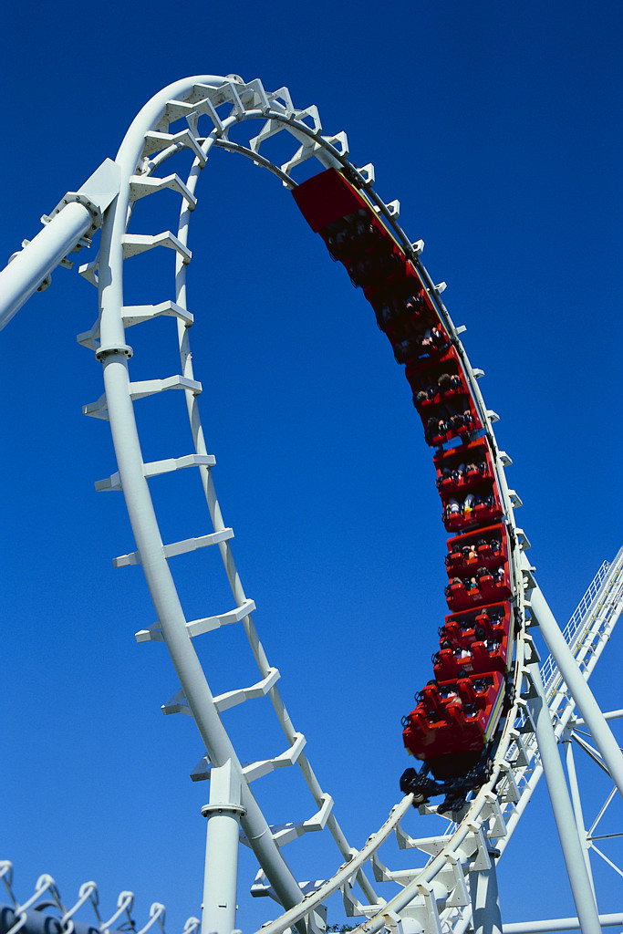
Roller Coaster Design Challenge
Problem: Design a fun and safe roller coaster for a marble!
Criteria:
  Marble must complete at least one loop (a full circle where the marble goes upside down)
  Marble must climb up at least one hill, the second hill must be taller than the first
  Marble must travel at least 8 feet total
  Challenge: Marble completes a horizontal “twist”
Constraints:
  You cannot add any force to the marble (i.e., you cannot push the marble at any time, only gently release it at the beginning of your track)
  Your marble must stay in contact with the track at all times
  You must complete your roller coaster in 15 minutes
  You can only use the following materials:
    2 x 6 foot sections of track
    Masking tape
    Props readily available in room (chairs, table, books, etc.)

Slide 5
Roller Coaster Design Challenge
What steps did your group take to solve this problem?

Slide 6
Roller Coaster Design Challenge
What steps did your group take to solve this problem?
Design
Develop Solutions
Optimize

Slide 7
Roller Coaster Design Challenge
Where do you see the science and engineering practices in this activity?

Slide 8
Roller Coaster Design Challenge
What crosscutting concepts were evident in this activity?

Slide 9
Roller Coaster Design Challenge
What disciplinary core ideas/content standards were addressed in this activity?
  PS3A. Definitions of Energy
  PS3B. Conservation of Energy and Energy Transfer
  3.PS3: Energy 1) Recognize that energy is present when objects move; describe the effects of energy transfer from one object to another.
  4.PS3: Energy 1) Use evidence to explain the cause and effect relationship between the speed of an object and the energy of an object. 2) Observe and explain the relationship between potential energy and kinetic energy. 3) Describe how stored energy can be converted into another form for practical use.
  6.PS3: Energy 1) Analyze the properties and compare sources of kinetic, elastic potential, gravitational potential, electric potential, chemical, and thermal energy. 2) Construct a scientific explanation of the transformations between potential and kinetic energy. 3) Analyze and interpret data to show the relationship between kinetic energy and the mass of an object in motion and its speed.
  PSCI.PS3: Energy 1) Identify and give examples of the various forms of energy (kinetic, gravitational potential, elastic potential) and solve mathematical problems regarding the work-energy theorem and power 5) Investigate the relationships among kinetic, potential, and total energy within a closed system (the law of conservation of energy).
  PHYS.PS3: Energy 1) Identify and calculate different types of energy and their transformations (thermal, kinetic, potential, including magnetic and electrical potential energies) from one form to another in a system 3) Use the principle of energy conservation and mathematical representations to quantify the change in energy of one component of a system when the energy that flows in and out of the system and the change in energy of the other components is known.

Slide 10
Engineering in the Standards
Where do we see engineering in the standards?
  Science and Engineering Practices
  Disciplinary Core Ideas
Today’s Focus

Slide 11
Engineering DCI’s
Notes:
Focus today on ETS1, but not every topic lends itself to a design challenge.

Slide 12
How to Integrate Engineering
ETS1: Engineering Design
Design briefs
  Problem Statement
  Criteria / Specifications
  Constraints
Timeline
  Include time for prototypes, testing, multiple iterations
  Older grades: comparing and testing multiple prototypes
Connect to the standards

Slide 13
Engineering Design Progression
K-2 | 3-5 | 6-8 | 9-12
ETS1.A: Defining and delimiting an engineering problem
Identify situations that people want to change as problems that can be solved through engineering
ETS1.B: Developing Possible Solutions
Convey possible solutions through visual or physical representations
ETS1.C: Optimizing the Design Solution
Compare solutions, test them, and evaluate each

Slide 14
Engineering Design Progression
K-2 | 3-5 | 6-8 | 9-12
ETS1.A: Defining and delimiting an engineering problem
Identify situations that people want to change as problems that can be solved through engineering | Specify criteria and constraints that a possible solution to a simple problem must meet
ETS1.B: Developing Possible Solutions
Convey possible solutions through visual or physical representations | Research and explore multiple possible solutions
ETS1.C: Optimizing the Design Solution
Compare solutions, test them, and evaluate each | Improve a solution based on results of simple tests, including failure points

Slide 15
Engineering Design Progression
K-2 | 3-5 | 6-8 | 9-12
ETS1.A: Defining and delimiting an engineering problem
Identify situations that people want to change as problems that can be solved through engineering | Specify criteria and constraints that a possible solution to a simple problem must meet | Attend to precision of criteria and constraints and considerations likely to limit possible solutions
ETS1.B: Developing Possible Solutions
Convey possible solutions through visual or physical representations | Research and explore multiple possible solutions | Combine parts of different solutions to create new solutions
ETS1.C: Optimizing the Design Solution
Compare solutions, test them, and evaluate each | Improve a solution based on results of simple tests, including failure points | Use systematic processes to iteratively test and refine a solution

Slide 16
Engineering Design Progression
K-2 | 3-5 | 6-8 | 9-12
ETS1.A: Defining and delimiting an engineering problem
Identify situations that people want to change as problems that can be solved through engineering | Specify criteria and constraints that a possible solution to a simple problem must meet | Attend to precision of criteria and constraints and considerations likely to limit possible solutions | Attend to a broad range of considerations in criteria and constraints for problems of social and global significance
ETS1.B: Developing Possible Solutions
Convey possible solutions through visual or physical representations | Research and explore multiple possible solutions | Combine parts of different solutions to create new solutions | Break a major problem into smaller problems that can be solved separately
ETS1.C: Optimizing the Design Solution
Compare solutions, test them, and evaluate each | Improve a solution based on results of simple tests, including failure points | Use systematic processes to iteratively test and refine a solution | Prioritize criteria, consider trade-offs, and assess social and environmental impacts as a complex solution is tested and refined

Slide 17
How to Integrate Engineering
ETS2: Links Among Engineering, Technology, and Society
Analyzing engineered systems, technologies and impact on society
  Debates, presentations
Researching technological advances
  Tracing how advances in science and engineering lead to new technology and vice versa
  Creating timelines of advances

Slide 18
K-2 | 3-5 | 6-8 | 9-12
ETS2.A: Interdependence of Science, Engineering, and Technology
Science and engineering involve the use of tools to observe and measure things.
ETS2.B: Influence of Engineering, Technology, and Science on Society and the Natural World
Every human-made product is designed by applying some knowledge of the natural world and is built by using natural materials. Taking natural materials to make things impacts the environment.

Slide 19
K-2 | 3-5 | 6-8 | 9-12
ETS2.A: Interdependence of Science, Engineering, and Technology
Science and engineering involve the use of tools to observe and measure things. | Science and technology support each other. Tools and instruments are used to answer scientific questions, while scientific discoveries lead to the development of new technologies.
ETS2.B: Influence of Engineering, Technology, and Science on Society and the Natural World
Every human-made product is designed by applying some knowledge of the natural world and is built by using natural materials. Taking natural materials to make things impacts the environment. | People’s needs and wants change over time, as do their demands for new and improved technologies. Engineers improve existing technologies or develop new ones to increase their benefits, decrease known risks, and meet societal demands. When new technologies become available, they can bring about changes in the way people live and interact with one another.

Slide 20
K-2 | 3-5 | 6-8 | 9-12
ETS2.A: Interdependence of Science, Engineering, and Technology
Science and engineering involve the use of tools to observe and measure things. | Science and technology support each other. Tools and instruments are used to answer scientific questions, while scientific discoveries lead to the development of new technologies. | Engineering advances have led to important discoveries in virtually every field of science and scientific discoveries have led to the development of entire industries and engineered systems. Science and technology drive each other forward.
ETS2.B: Influence of Engineering, Technology, and Science on Society and the Natural World
Every human-made product is designed by applying some knowledge of the natural world and is built by using natural materials. Taking natural materials to make things impacts the environment. | People’s needs and wants change over time, as do their demands for new and improved technologies. Engineers improve existing technologies or develop new ones to increase their benefits, decrease known risks, and meet societal demands. When new technologies become available, they can bring about changes in the way people live and interact with one another. | All human activity draws on natural resources and has both short and long-term consequences, positive as well as negative, for the health of people and the natural environment. The uses of technologies and any limitations on their use are driven by individual or societal needs, desires, and values; by the findings of scientific research; and by differences in such factors as climate, natural resources, and economic conditions. Technology use varies over time and from region to region.

Slide 21
K-2 | 3-5 | 6-8 | 9-12
ETS2.A: Interdependence of Science, Engineering, and Technology
Science and engineering involve the use of tools to observe and measure things. | Science and technology support each other. Tools and instruments are used to answer scientific questions, while scientific discoveries lead to the development of new technologies. | Engineering advances have led to important discoveries in virtually every field of science and scientific discoveries have led to the development of entire industries and engineered systems. Science and technology drive each other forward. | Science and engineering complement each other in the cycle known as research and development (R&D). Many R&D projects may involve scientists, engineers, and others with wide ranges of expertise.
ETS2.B: Influence of Engineering, Technology, and Science on Society and the Natural World
Every human-made product is designed by applying some knowledge of the natural world and is built by using natural materials. Taking natural materials to make things impacts the environment. | People’s needs and wants change over time, as do their demands for new and improved technologies. Engineers improve existing technologies or develop new ones to increase their benefits, decrease known risks, and meet societal demands. When new technologies become available, they can bring about changes in the way people live and interact with one another. | All human activity draws on natural resources and has both short and long-term consequences, positive as well as negative, for the health of people and the natural environment. The uses of technologies and any limitations on their use are driven by individual or societal needs, desires, and values; by the findings of scientific research; and by differences in such factors as climate, natural resources, and economic conditions. Technology use varies over time and from region to region. | Modern civilization depends on major technological systems, such as agriculture, health, water, energy, transportation, manufacturing, construction, and communications. Engineers continuously modify these systems to increase benefits while decreasing costs and risks. New technologies can have deep impacts on society and the environment, including some that were not anticipated. Analysis of costs and benefits is a critical aspect of decisions about technology.

Slide 22
Engineering and the 5E’s
Engage
Explore
Explain
Elaborate
Evaluate
Which phase would you put the Roller Coaster design challenge into?
Ideas:
  Explore, to develop concepts of conservation of energy, types of energy
  Elaborate, to apply concepts of conservation of energy
  As a large scale project

Slide 23
Engineering Resources
K-2 Resources: https://ngss.nsta.org/DisplayStandard.aspx?view=topic&id=10
3-5 Resources: https://ngss.nsta.org/DisplayStandard.aspx?view=topic&id=23
Middle School Resources: https://ngss.nsta.org/DisplayStandard.aspx?view=topic&id=39.
High School Resources: https://ngss.nsta.org/DisplayStandard.aspx?view=topic&id=55

Slide 24
Grade Bands
Read through the activity
Where/how is engineering incorporated?
What DCI is addressed?
Where do you see the SEPs and CCCs?
How could you incorporate this in your class?
  Where in the 5E Learning Cycle would you use this?
  What adjustments might you make for your students?
  What challenges do you see with using this activity?

Slide 25
Wrap-Up
Lending Library at U of M
Degree Programs at U of M
  MAT: licensure
  MS and EdD: Advance your craft

Slide 26

Wrap-Up
Door Prizes!
Please complete interest survey before leaving. Use the link in your email or the QR Code below.
Link available at: memphisscience.wixsite.com/MAST

