Slide 1

Do-Now
Complete the sentence: Literacy in science is important because…
Go to menti.com
Enter code 41 83 82
Notes:
https://www.mentimeter.com/app

Slide 2


Science Share-A-Thon
November 2, 2019

Slide 3
Overview
Our agenda for today:
9:00 – 9:30: Continental breakfast, check-in, mingle
9:30 – 10:00: Literacy and 3-D Science Learning
10:00 – 11:20: Grade band literacy integration examples
11:20 – 11:30: Wrap up, door prizes, interest survey

Slide 4
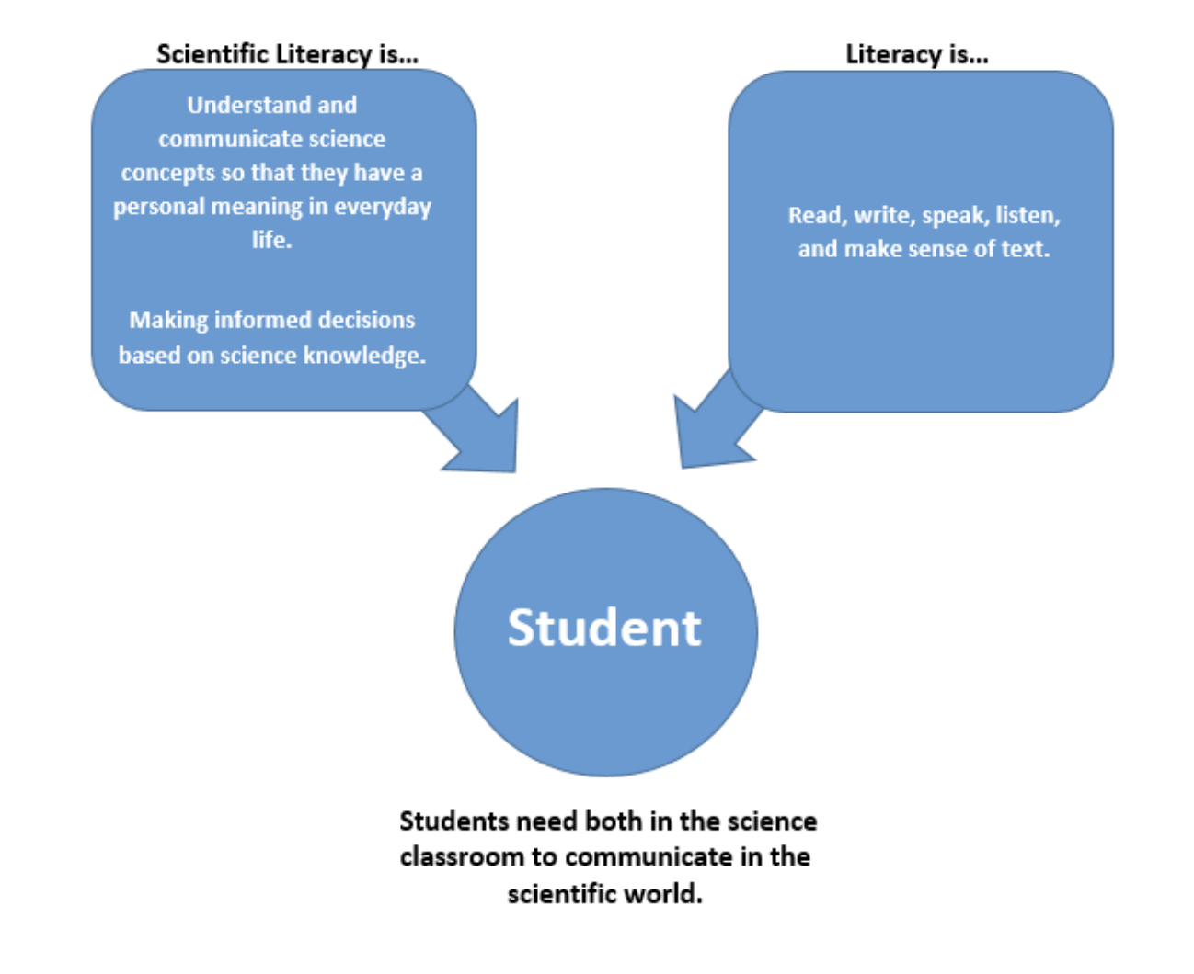
Literacy and Scientific Literacy

Slide 5
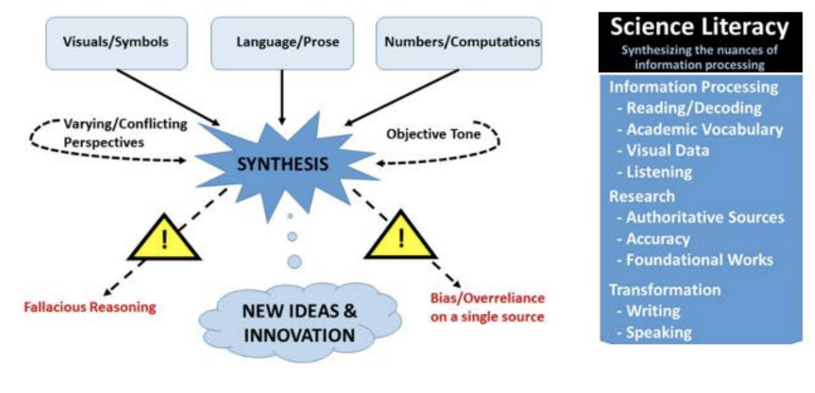

Slide 6
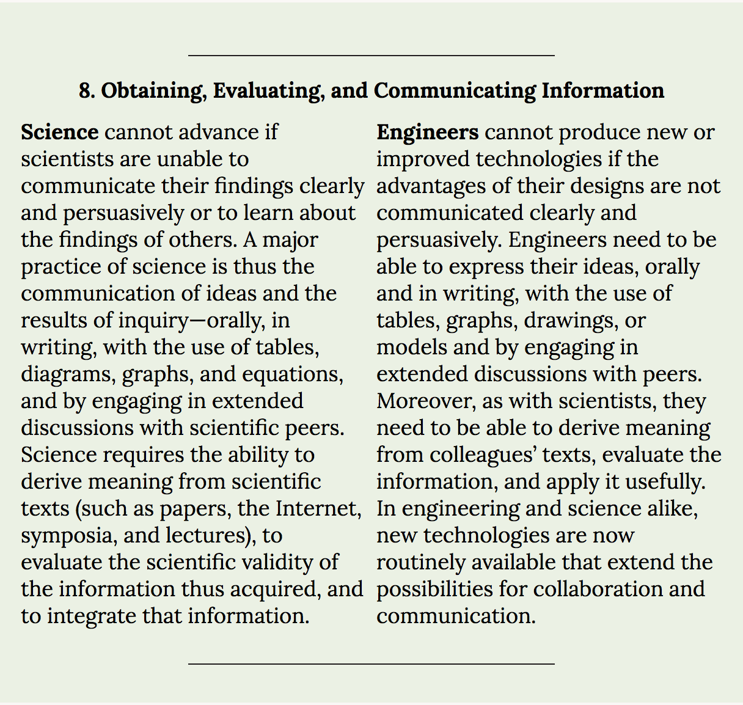
Literacy in the SEPs

Slide 7
From the Framework:
Being literate in science and engineering requires the ability to read and understand their literatures [34]. Science and engineering are ways of knowing that are represented and communicated by words, diagrams, charts, graphs, images, symbols, and mathematics [35]. Reading, interpreting, and producing text* are fundamental practices of science in particular, and they constitute at least half of engineers’ and scientists’ total working time [36].
Even when students have developed grade-level-appropriate reading skills, reading in science is often challenging to students for three reasons. First, the jargon of science texts is essentially unfamiliar; together with their often extensive use of, for example, the passive voice and complex sentence structure, many find these texts inaccessible [37]. Second, science texts must be read so as to extract information accurately. Because the precise meaning of each word or clause may be important, such texts require a mode of reading that is quite different from reading a novel or even a newspaper. Third, science texts are multimodal [38], using a mix of words, diagrams, charts, symbols, and mathematics to communicate. Thus understanding science texts requires much more than simply knowing the meanings of technical terms.
Communicating in written or spoken form is another fundamental practice of science; it requires scientists to describe observations precisely, clarify their thinking, and justify their arguments. Because writing is one of the primary means of communicating in the scientific community, learning how to produce scientific texts is as essential to developing an understanding of science as learning how to draw is to appreciating the skill of the visual artist. Indeed, the new Common Core State Standards for English Language Arts & Literacy in History/Social Studies, Science, and Technical Subjects [39] recognize that reading and writing skills are essential to science; the formal inclusion in this framework of this science practice reinforces and expands on that view. Science simply cannot advance if scientists are unable to communicate their findings clearly and persuasively. Communication occurs in a variety of formal venues, including peer-reviewed journals, books, conference presentations, and carefully constructed websites; it occurs as well through informal means, such as discussions, email messages, phone calls, and blogs. New technologies have extended communicative practices, enabling multidisciplinary collaborations across the globe that place even more emphasis on reading and writing. Increasingly, too, scientists are required to engage in dialogues with lay audiences about their work, which requires especially good communication skills.
Being a critical consumer of science and the products of engineering, whether as a lay citizen or a practicing scientist or an engineer, also requires the ability to read or view reports about science in the press or on the Internet and to recognize the salient science, identify sources of error and methodological flaws, and distinguish observations from inferences, arguments from explanations, and claims from evidence. All of these are constructs learned from engaging in a critical discourse around texts.

Slide 8
Literacy in Science
Science has unique literacy demands – words, diagrams, charts, symbols, etc.
Literacy isn’t just for students – it’s a primary practice of scientists, reading (taking in information) and writing (communicating information)
Literacy in science has unique challenges – jargon, inaccessible texts, precise meanings, multimodal texts
Literacy in science is important for an educated citizenry

Slide 9
Goals
By grade 12, students should be able to
• Use words, tables, diagrams, and graphs (whether in hard copy or electronically), as well as mathematical expressions, to communicate their understanding or to ask questions about a system under study.
• Read scientific and engineering text, including tables, diagrams, and graphs, commensurate with their scientific knowledge and explain the key ideas being communicated.
• Recognize the major features of scientific and engineering writing and speaking and be able to produce written and illustrated text or oral presentations that communicate their own ideas and accomplishments.
• Engage in a critical reading of primary scientific literature (adapted for classroom use) or of media reports of science and discuss the validity and reliability of the data, hypotheses, and conclusions.

Slide 10
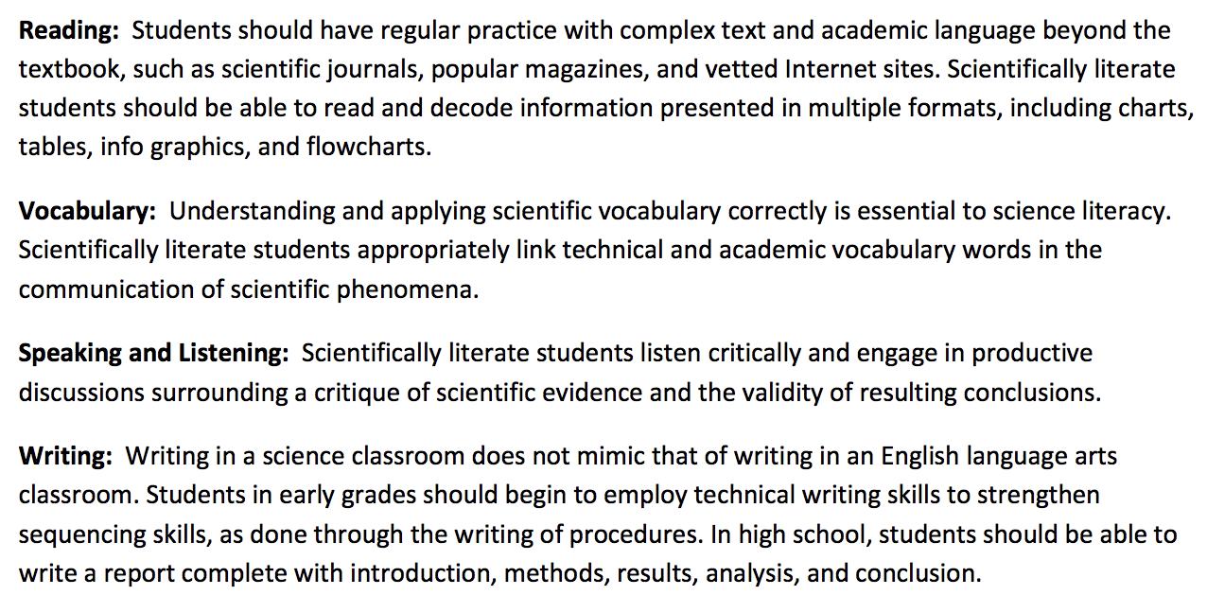
From the TN Science Standards

Slide 11
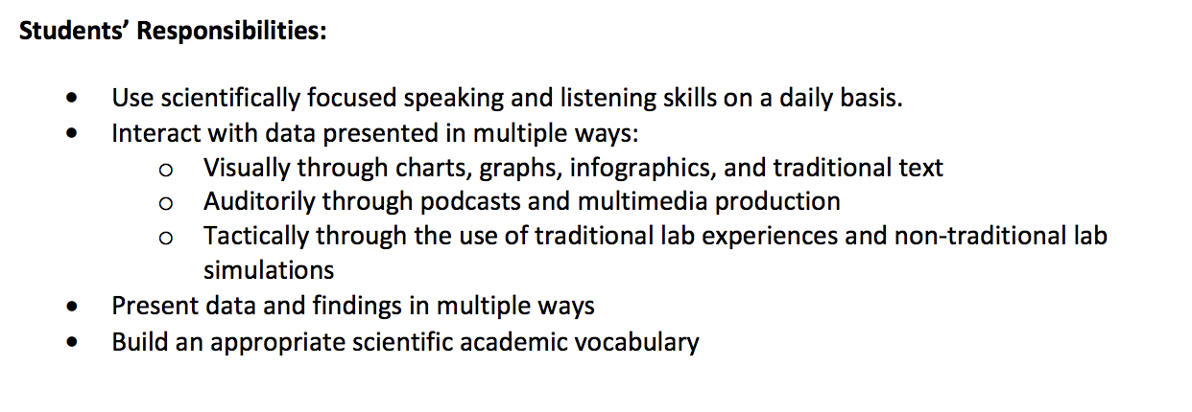
Students should…

Slide 12
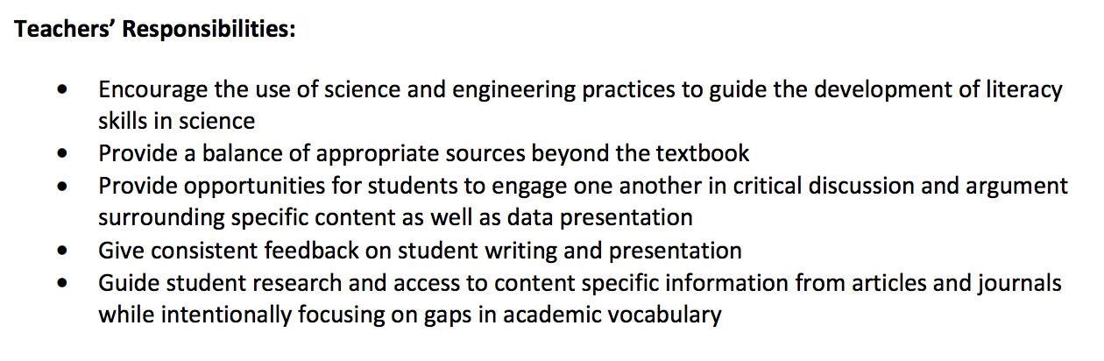
Teachers should…

Slide 13
Examples of Literacy in Science Class
With your group, brainstorm a list of all of the ways you have incorporated literacy in your class.
Pick examples that engage the students in:
  Reading
  Vocabulary
  Speaking and Listening
  Writing

Slide 14
What does this look like in a science class?
Can be included in any phase of the 5E Learning Cycle
  Engage: read engaging news article about topic, write down thoughts/questions
  Explore: do online research, readings; write about explorations in science journal
  Explain: Read from textbook or other reference material, take notes connected to explore phase
  Elaborate: do online research, readings; write about explorations in science journal
  Evaluate: read/write about new situation

Slide 15
Challenges
Supports: Not all students will be on the same level
  Finding appropriate readings
    Sciencedaily.com
    Physicsclassroom.com
  Leveling readings
    See https://newsela.com/
  Providing scaffolding for students
    Ex: cloze notes, sentence stems, word banks

Slide 16
Example: Notes
Creating guided Cornell notes from a textbook reading

Slide 17
Example: Jigsaw
Differentiate readings within groups but hold all students accountable

Slide 18
SCS Observation Tool
Where do you see literacy on the tool?

Slide 19
Grade Band Breakouts
Elementary:
  Wind Energy, Poplar Room 308
Middle and High:
  Penguins, stay here!

Slide 20
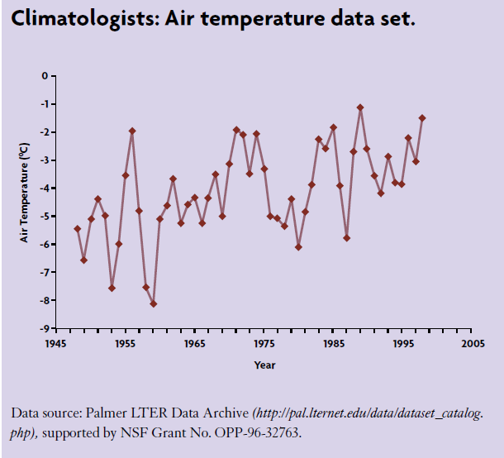
Penguin Case Study
What do you observe in the data?
Considering this data, what effect do you think it will have on living and nonliving systems in Antarctica?

Slide 21
Penguin Case Study
You will be working in teams of environmental scientists
Each scientist in the team will have a specialist role
The goal of the investigation is to determine how climate change is impacting penguin populations in Antarctica
Today, specialists will meet and gather information
Tomorrow, specialists will report back to their teams.

Slide 22
Specialists
Ornithologist: A scientist who studies birds. Uses visual surveys (from ships or land), diet analysis, and satellite tracking to collect data on Penguins
Oceanographer: A scientist who studies the ocean. Uses satellite imagery, underwater sensors, and manual measurements of sea ice thickness to collect data on sea ice conditions and ocean temperature
Meteorologist: A scientist who studies the weather. Uses automatic weather stations and visual observations of the skies to collect data on precipitation, temperature, and cloud cover
Marine Ecologist: A scientist who studies the relationship between organisms and their ocean environment. Uses visual surveys, diet analysis, and satellite tracking to collect data on a variety of organisms, including penguins.
Biologist: A scientist who studies fish and their prey. Collects data on krill during research vessel cruises.

Slide 23
Penguin Case Study
Specialist | Group 1 | Group 2 | Group 3 | Group 4
Biologist | Adonica | Pam / Shantrecia | Damahya / Jarnevia | Jazmin
Marine Ecologist | Kenya | Charmaine | Miracle | Bryttani
Ornithologist | Raytecia | Sequoyah | Deshonna | Cadidra
Meteorologist | Angela | Shanettay | Jewel | Shazmine
Oceanographer | Quadron | Keyana | Tyra | Natashia
In your specialist groups:
Read the information provided about your specialty
Create a graph of the data provided
Identify patterns in your data
Brainstorm reasons that could cause those patterns

Slide 24
Home Groups
When you return to your home group:
First, each specialist takes 90 seconds to brief their group
Then, the group will assemble their flow chart
  For each dataset, determine whether the trend is “increasing” or “decreasing” and mark with a large arrow
  Use the skinny arrows to show direct relationships between data sets

Slide 25
Example flow chart
AIR TEMPERATURE
WILDFIRES
HARDWOODS
PINES

Slide 26

Wrap-Up
Door Prizes!
Certificates of completion?
Please complete interest survey before leaving. Use the link in your email or the QR Code below.

