Slide 1

Do-Now
What questions do you have about the new TN Science Standards?
Go to menti.com
Enter code 56 66 06
Notes:
https://www.mentimeter.com/app

Slide 2


Science Share-A-Thon
January 20, 2018

Slide 3
Overview
Our agenda for today:
9:00 – 9:30: Continental breakfast, check-in, mingle
9:30 – 9:45: Introduction, goals of group
9:45 – 10:20: Overview of TN Science Standards
10:20 – 11:20: Break out into grade bands to share lesson plans
11:20 – 11:30: Wrap up, door prizes, interest survey

Slide 4
Introduction
What is this group?
What are our goals?
Teacher interest survey at the end of today’s session

Slide 5

Memphis Area Science Teachers
A teacher-centered, teacher-led group for any one in the Memphis area interested in Science Education
Bring teachers together to:
  Collaborate
  Share resources
  Learn
Website:
Listserv: join today or through website

Slide 6
TN Academic Standards for Science
Teachers will begin using the new standards 2018-2019
Assessments will be administered but scores will not be distributed the first year
Our goal today is to give a broad overview of what to expect and to start a conversation

Slide 7

TN Academic Standards for Science
The whole country has engaged in a re-thinking of how we teach science to students K-12
Two new documents:
  A Framework for K-12 Science Education
  Next Generation Science Standards
  Tennessee Academic Standards for Science
https://www.nap.edu/catalog/13165/a-framework-for-k-12-science-education-practices-crosscutting-concepts
https://www.tn.gov/content/dam/tn/stateboardofeducation/documents/meeting_oct_20_17/10-20-17_III_J_Non-Substantive_Changes_to_Math_ELA__Science_Standards_Attachment_3_-_Science.pdf

Slide 8
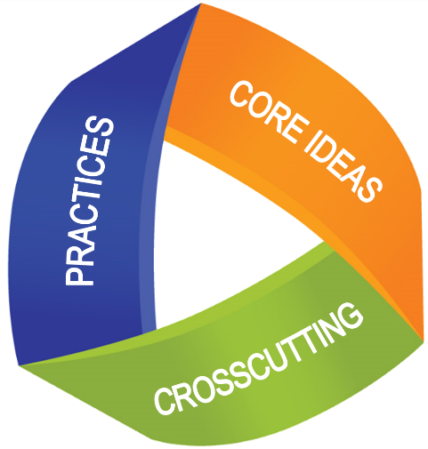
TN Academic Standards for Science
Biggest Change: 3-Dimensional Science Teaching and Learning
“K-12 science and engineering education should focus on a limited number of disciplinary core ideas and crosscutting concepts, be designed so that students continually build on and revise their knowledge and abilities over multiple years, and support the integration of such knowledge and abilities with the practices needed to engage in scientific inquiry and engineering design.”

Slide 9
Disciplinary Core Ideas
Smaller set of core content ideas
Learning progressions explicitly built into standards
Some content has shifted among grades – especially k-8
Focus on depth instead of breadth means some content no longer taught

Slide 10
From p. 13 of TN Science Standards

Slide 11
Science and Engineering Practices
Focus on the “actual doing of science”
Not one scientific method
Inclusion of both science and engineering
Specific set of practices to replace vagueness of “Inquiry”

Slide 13
Crosscutting Concepts
“Concepts that bridge disciplinary boundaries, having explanatory value throughout much of science and engineering”
Explicit reference to these concepts in regular instruction

Slide 15
Phenomena-Based Learning
Teaching in context to help students understand THEIR world

Slide 16
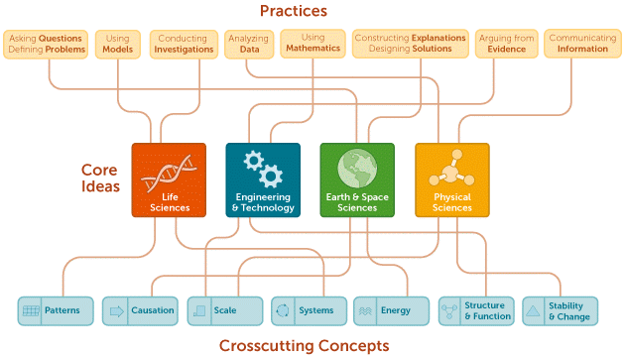
3-D Science Teaching

Slide 17
Lesson Plans
Grade band break-outs:
  Elementary – stay here!
  Middle – Room 225
  High School – Room 226
Come back here at 11:20 for wrap-up

Slide 18
Lesson Plans
Take about 20 minutes to read over the lesson plan for your content area and try out the activity
  On the lesson plan, identify the scientific and engineering practices
  Where do you see evidence of crosscutting concepts?
With your group, share what you noted on your lesson plan
For discussion:
  How would this work in your classroom?
  What changes would you make?
  What questions/concerns do you have?

Slide 19
Wrap-Up
Door Prizes!
Please complete interest survey before leaving. Use the link in your email or the QR Code below.
Link available at: memphisscience.wixsite.com/MAST

